Slide 1

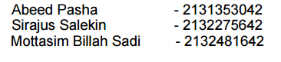

Slide 2
Vision Statement:
To be the world's premier platform that empowers business professionals to connect, collaborate, and thrive in a dynamic global marketplace, fostering innovation, growth, and success through meaningful and lasting professional relationships.

Slide 3
Functional Requirements
Users have a profile page with their posts, descriptions, followers, following and chats that can be changed.
Profiles can be verified and authenticated using OTP sent via email.
News-feed that shows all posts and comments by accounts followed by the user.
Chat and calls options available for users to communicate with each other.
Order management tab that shows list of orders received by a seller, user can confirm or reject orders and manage transactions and payments.
Transaction Details and logs of texts, calls and news-feed activity with notification system to alert user of changes and updates.
Payment System with secured transactions for buyers to make purchases.
Creating posts, sharing and commenting on posts which will have interactive features like direct order confirmations.
Partnership Tab with search, collaboration options and suggestions based on past partnerships.

Slide 4
Non-Functional Requirements
Synchronized System between partners for up-to-date and coherent information across all users.
Responsive And Secured Payment Portals with Feedback, authentication and notifications through email and SMS.
Real-time texts and stable call rooms
Consensual modification of partnership details/documents/transactions and notifications of edits to all involved parties.
Orders in the order management tab should be responded within a time limit of 24 hours before being automatically rejected.
Easy to navigate interface for quick usage to avoid needless waste of time for busy users.
Maintenance Period Of 30 Minutes During Late Night, after 3am when traffic is lowest.
2 tier authentication for login, signup and transactions.
Profiles and posts support multimedia images, videos, etc. for promoting their business.
Promotional video, services, products, items sellers offer in the profile.
Hashtags on posts to enable ease of searching posts, other profiles and be featured on newsfeeds of relevant users.

Slide 5
Use Case Name: User login
Actor: User
Scenario: 1. Input user Id and password
2. Authentication of login details
3. Save Id and password
4. Remember details and autofill
Exception: 1. Wrong login details
2. Connection lost
Precondition: 1. Page URL
Post Condition: 1. Successful login - login and move to homepage, change status to online
2. Unsuccessful login - error message
3. Connection lost - remain in same page

Slide 6
Use Case Name: Create User account
Actor: User
Scenario: 1. Input user Id, password, confirm password
2. Select type of account - business profile/buyer profile
3. Check id and password unique or not
4. Add user to database
Exception: 1. Duplicate login details
2. Connection lost
Precondition: 1. Page URL
Post Condition: 1. Successful creation and business profile selected - login and move to
business profile creation
2. Successful creation and buyer profile selected - login and move to buyer
profile creation
3. Unsuccessful creation/duplicate user found- error message, user not
added to database
4. Connection lost - remain in same page

Slide 7
Use Case Name: Business profile creation
Actor: User(Business Profile)
Scenario: 1. Add business name, description/bio, date of establishment, address, contact
details
2. Add products and services available
3. Add profile picture
4. Select search keywords(to facilitate searching of business profiles)
Exception: 1. Unsupported Text or symbols
2. Image size or format issue
3. Connection lost
Precondition: 1. Page URL and account exists
Post Condition: 1. Successful- move to homepage
2. Unsuccessful- error message, page emptied and remain in same page
3. Connection lost - remain in same page

Slide 8
Use Case Name: Buyer profile creation
Actor: User(Buyer Profile)
Scenario: 1. Add buyer name, description/bio, date of birth, address, contact details
2. Add interested products and services
3. Add profile picture
Exception: 1. Unsupported Text or symbols
2. Image size or format issue
3. Connection lost
Precondition: 1. Page URL and account exists
Post Condition: 1. Successful- move to homepage
2. Unsuccessful- error message, page emptied and remain in same page
3. Connection lost - remain in same page

Slide 9
Use Case Name: User logout
Actor: User
Scenario: 1. Ask for confirmation of logout
2. Disconnect from server
3. Change status to offline
Exception: 1. Unsaved changes
2. Connection lost
Precondition: 1. Page URL
Post Condition: 1. Successful logout - change status to offline, move to login page
2. Prompt to logout cancelled- stay in same page
3. Connection lost - stay in same page

Slide 10
Use Case Name: Make post
Actor: User(Business profile)
Scenario: 1. Text box to enter post details
2. Add related hashtags for further reach
3. Link to product and services list or exact product being posted about
4. Like counter set to 0
5. Comment section, initially empty
6. Post added to database
Exception: 1. Unsaved changes
2. Connection lost
Precondition: 1. Page URL
Post Condition: 1. Successful - move to profile page and show new post at top of timeline
2. Post cancelled - move back to homepage
3. Connection lost - move back to homepage

Slide 11
Use Case Name: Comment
Actor: User
Scenario: 1. Text box to enter comment details
2. Comment added to database with the post in question
Exception: 1. Unsaved changes
2. Connection lost
Precondition: 1. Page URL and post exists
Post Condition: 1. Successful - refresh page and show post with comment added
2. Comment cancelled - remain in page
3. Connection lost - remain in page

Slide 12
Use Case Name: Like post
Actor: User
Scenario: 1. Like button
2. Like counter beside like button in post incremented or decremented
Exception: 1. Connection lost
Precondition: 1. Page URL and post exists
Post Condition:1. Liked - like counter increased by 1, like button changes colour
2. Unliked - like counter decreased by 1, like button reverts to default colour
3. Connection lost - remain in page

Slide 13
Use Case Name: Delete post
Actor: User
Scenario: 1. confirmation button for deletion
2. Post deleted from database
Exception: 1. Connection lost
Precondition: 1. Page URL and post exists
Post Condition: 1. Successful delete - post removed from database, move to homepage
2. Delete cancelled - move to homepage
3. Connection lost - remain in page

Slide 14
Use Case Name: View profile
Actor: User
Scenario: 1. User profile selected and displayed
2. User timeline with all past posts displayed
3. option to display menu of products and services available
4. Make order from menu(buyer profile)
Exception: 1. Connection lost
Precondition: 1. Page URL and profile exists
Post Condition: 1. Successful - move to user profile page
2. Unsuccessful- show error message and move to homepage
3. Connection lost - move to homepage

Slide 15
Use Case Name: Search
Actor: User
Scenario: 1. Text box, enter keywords with hashtags or name of profile/products
2. List of posts and profiles filtered using hashtags and keywords is displayed
3. Can click to jump to selected post or profile
Exception: 1. Connection lost
2. No search results
Precondition: 1. Page URL
Post Condition: 1. Successful - list of profiles and posts displayed, move to selected page
2. Unsuccessful- show error message and empty list
3. Connection lost - move to homepage

Slide 16
Use Case Name: Chat
Actor: User
Scenario: 1. Text box, enter message, emojis
2. Send images/videos
3. Receive messages simultaneously, immediately updated in chat box
Exception: 1. Connection lost
Precondition: 1. Page URL and receiver user account exists
Post Condition: 1. Successful message sent- chat box updated
2. Unsuccessful message sent l- show error message and chat box
unchanged
3. Connection lost - error message showing network issue

Slide 17
Use Case Name: Call
Actor: User
Scenario: 1. In chat window, call option for real time
2. Send Call, receive call
3. Dial tone while attempting to connect
4. Receiver gets call notification
Exception: 1. Connection lost
2. Receiver offline
Precondition: 1. Page URL and receiver user account exists
Post Condition: 1. Successful call sent- Receiver Gets call ring
2. call not answered - show call declined message
3. Connection lost - error message showing network issue
4. Receiver not online - error message shown user not online

Slide 18
Use Case Name: Payment
Actor: User(Buyer)
Scenario: 1. Window showing amount to be paid and payment method
2. Enter business profile's wallet ID
3. Enter buyer password
4. Confirm password
5. Payment processed and amount deducted from buyer account and added to
business account
Exception: 1. Connection lost
2. authentication failed
3. Not enough balance
Precondition: 1. Page URL and receiver user account exists
Post Condition: 1. Successful payment - confirmation message sent to buyer, notification
sent to receiver, balance of both parties updated
2. Unsuccessful authentication - payment window closed and return to
previous page
3. Unsuccessful payment due to balance issue - error message shown,
payment window closed and return to previous page
4. Connection lost - error message showing network issue

Slide 19
Use Case Name: Order Manager
Actor: User
Scenario: 1. Menu showing list of orders received(business profile), or orders made(buyer
profile).
2. Order confirmation
3. Order details, description, amount
4. Option to pay for order(buyer profile)
Exception: 1. Connection lost
Precondition: 1. Page URL
Post Condition: 1. Order confirmed - confirmation message sender to buyer
2. Order list empty - show message that list is empty
3. Connection lost - error message showing network issue
4. Order payment - sent to payment window

Slide 20
Use Case Name: Show newsfeed
Actor: User
Scenario: 1. Page showing posts and profiles of relevant users
2. Can comment, like posts and search posts
Exception: 1. Connection lost
Precondition: 1. Page URL
Post Condition: 1. Successful retrieval of content - displays suggested posts and profiles
2. Connection lost - error message showing network issue

Slide 21
Use Case Name: Authenticate User
Actor: User
Scenario: 1. User credentials verified with database
2. If match, gives permission
3. If not does match, permission not given
Exception: 1. Connection lost
Precondition: 1. Page URL
Post Condition: 1. Credentials correct - confirmation message displayed and return to
previous page
2. Credentials incorrect - show error message and return to previous page
3. Connection lost - error message showing network issue

Slide 22
Use Case Name: Check Account Exists
Actor: User
Scenario: 1. Account searched for in database
2. If found, result saved and returned
3. If not found, show error
Exception: 1. Connection lost
Precondition: 1. Page URL
Post Condition: 1. Profile found - confirmation message displayed and return to previous
page
2. Profile not found - show error message and return to previous page
3. Connection lost - error message showing network issue

Slide 23
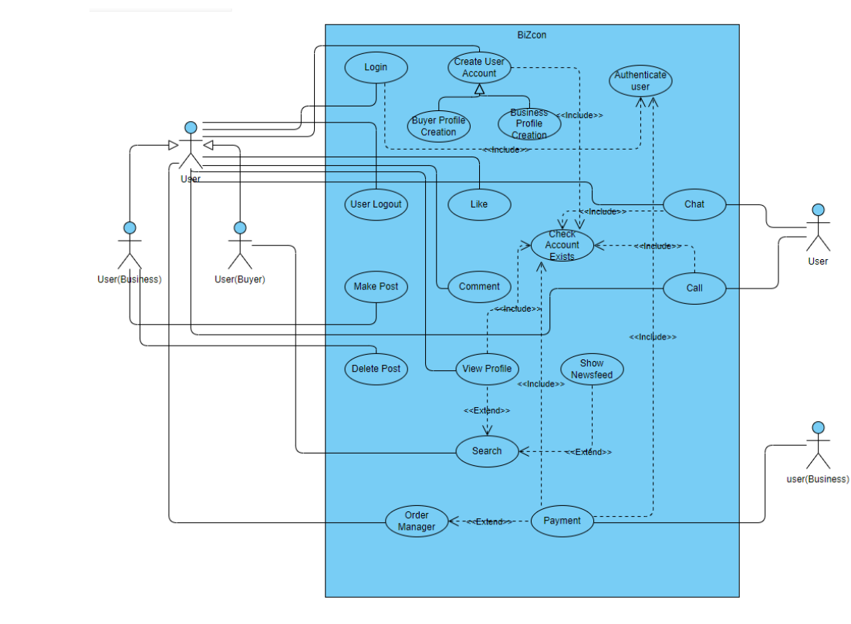

Slide 24
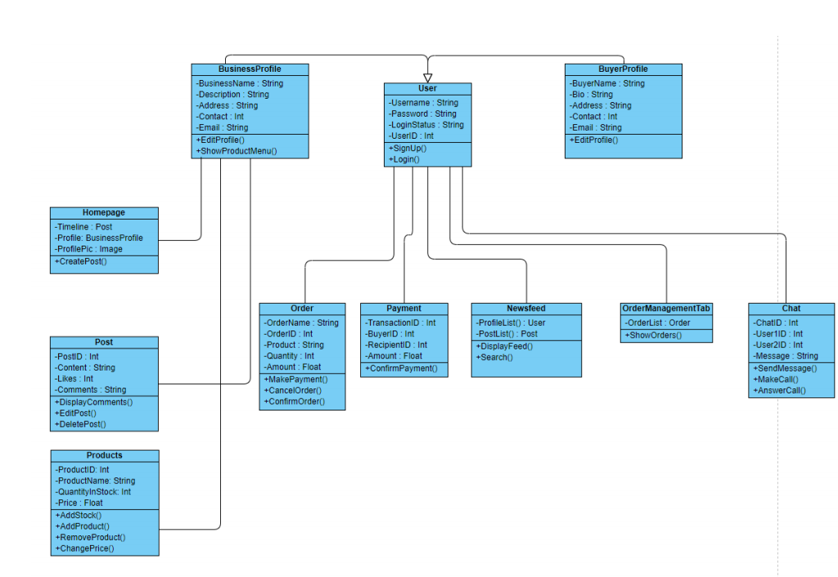

Slide 25
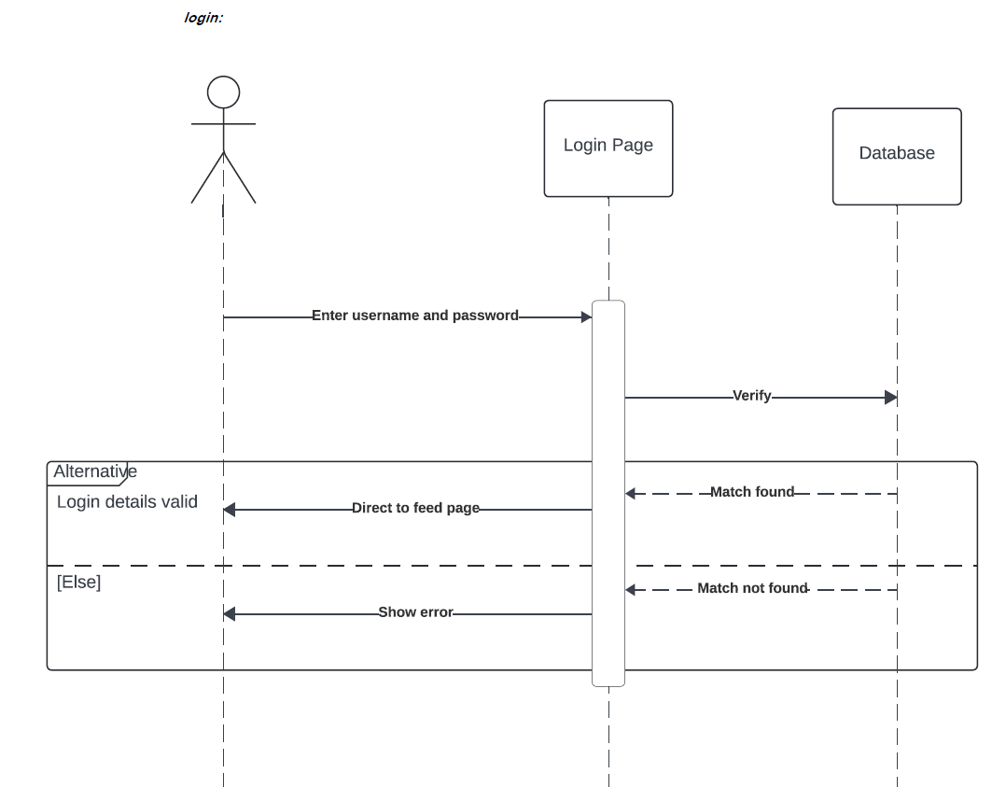

Slide 26
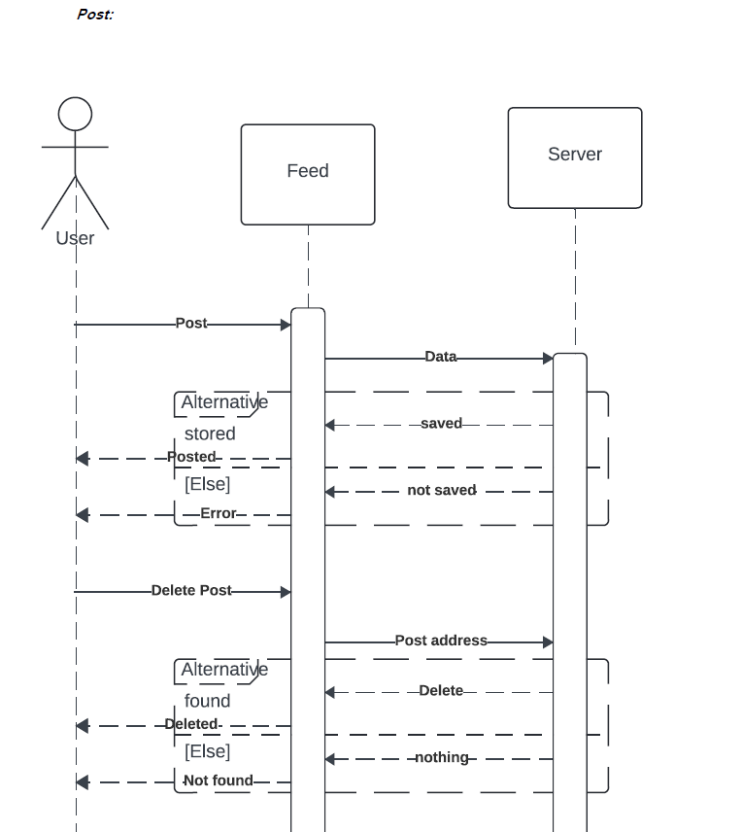
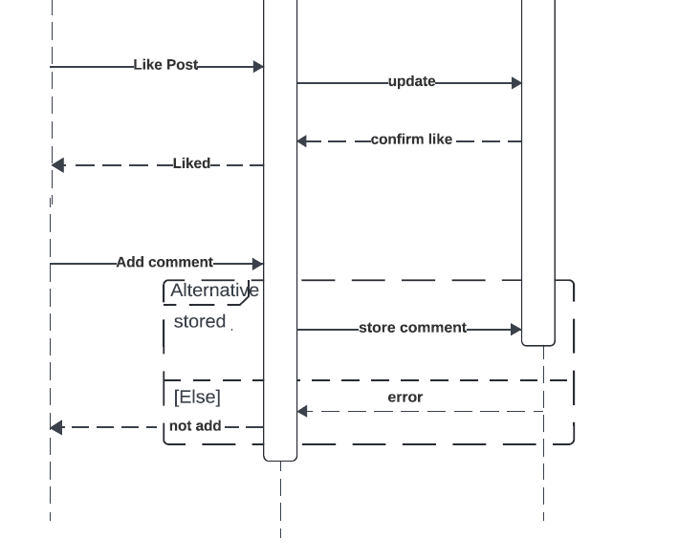

Slide 27
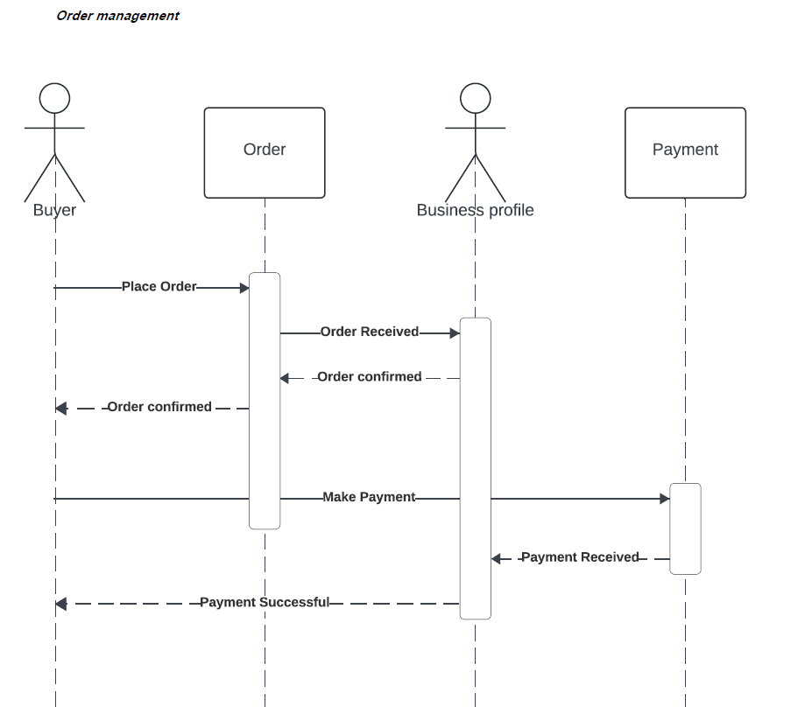

Slide 28
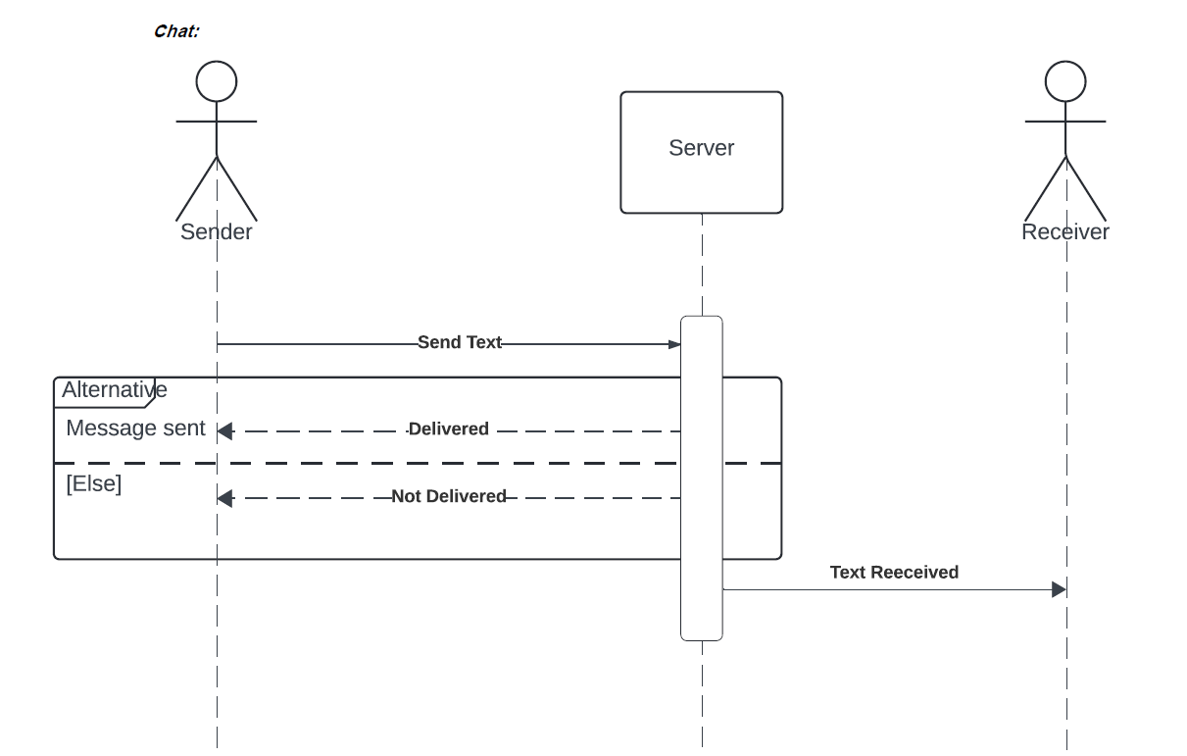
Text Received
Message Seen
Message Seen

Slide 29
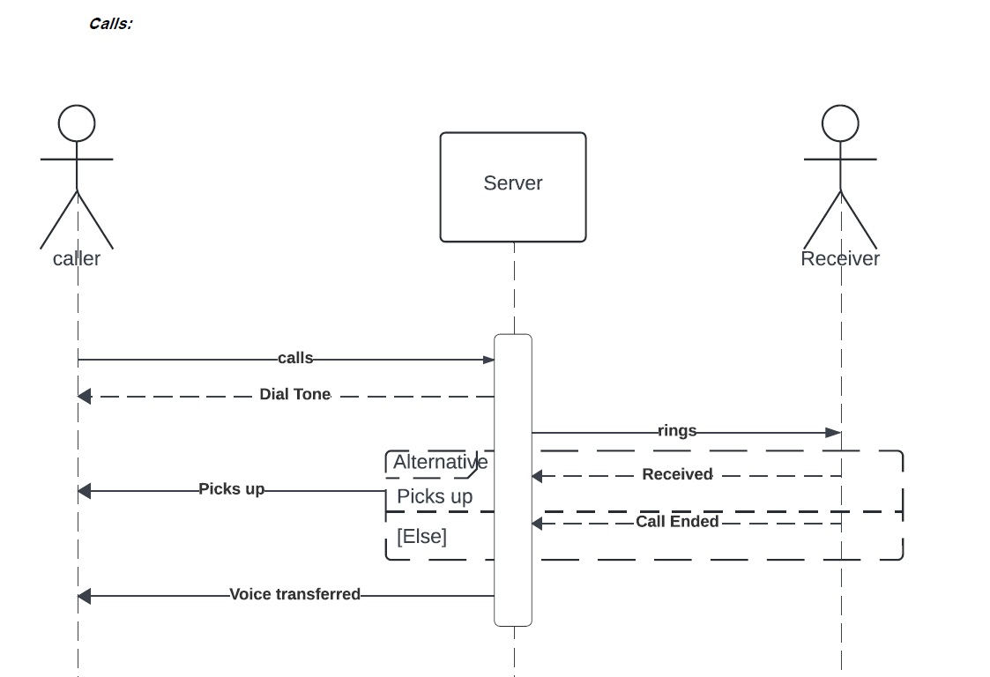

Slide 30
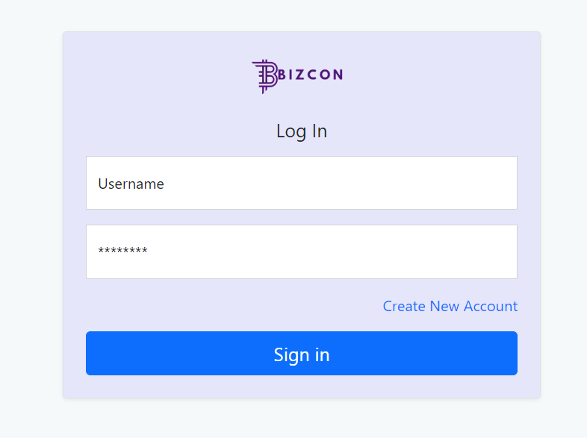

Slide 31
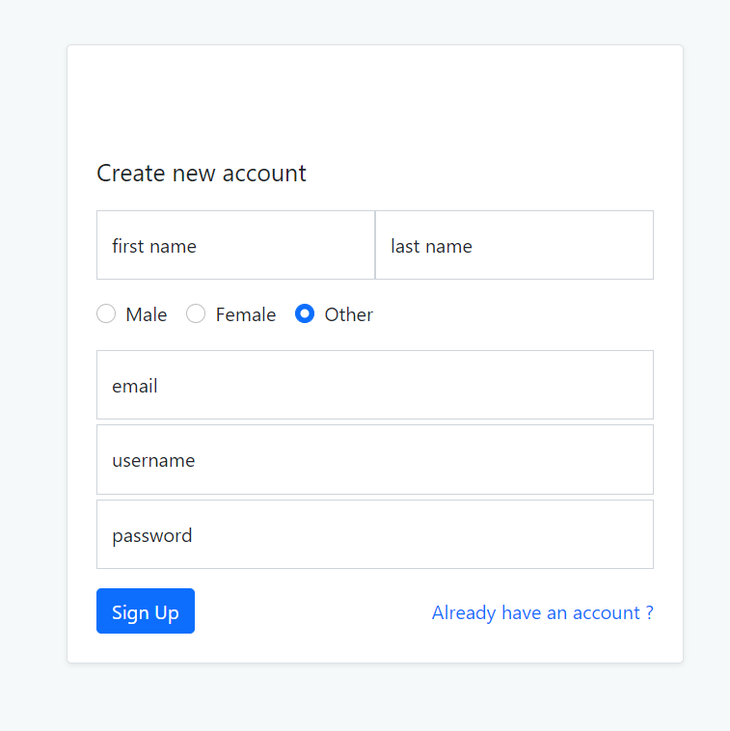

Slide 32
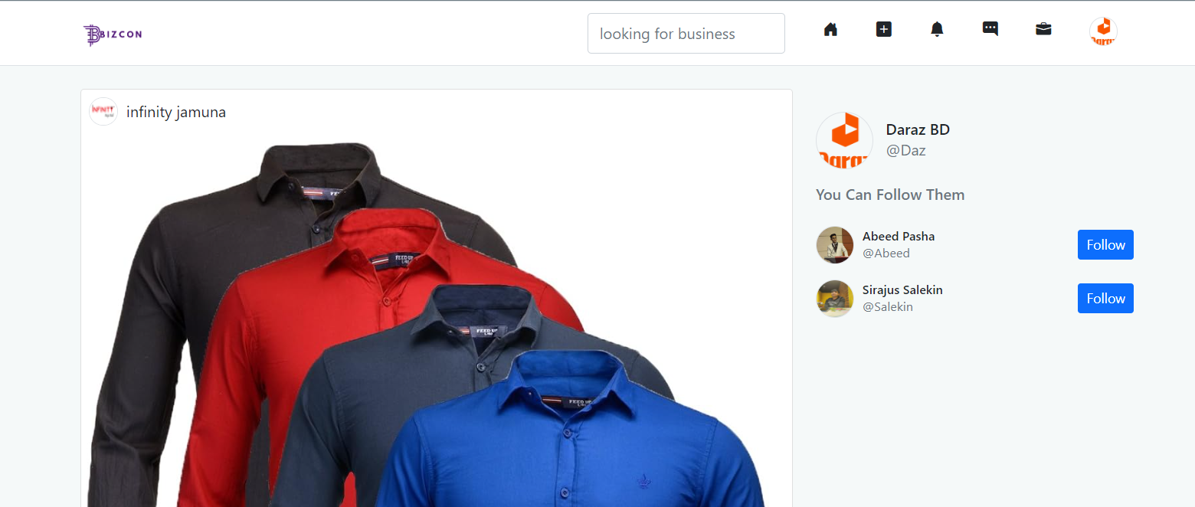

Slide 33
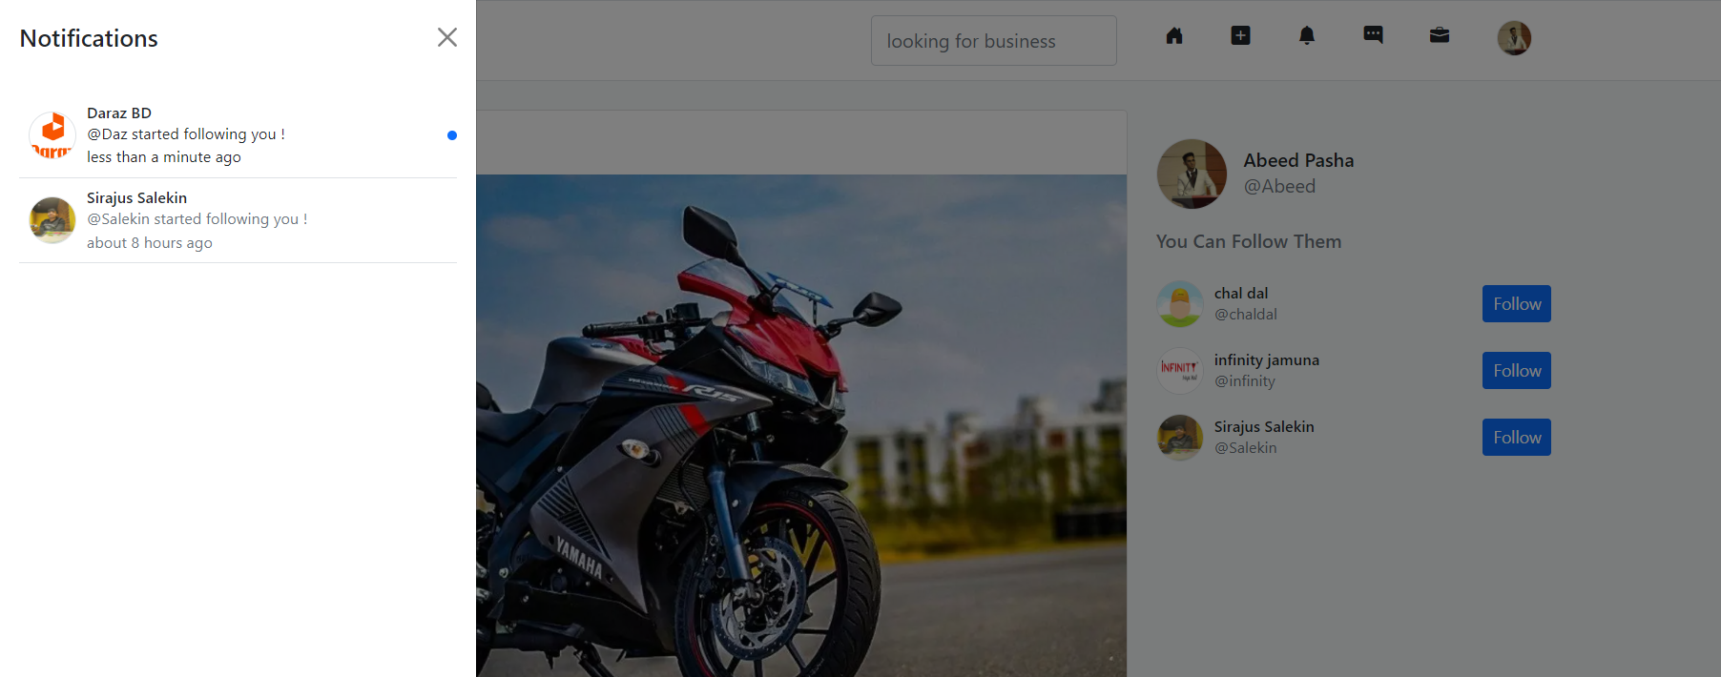

Slide 34
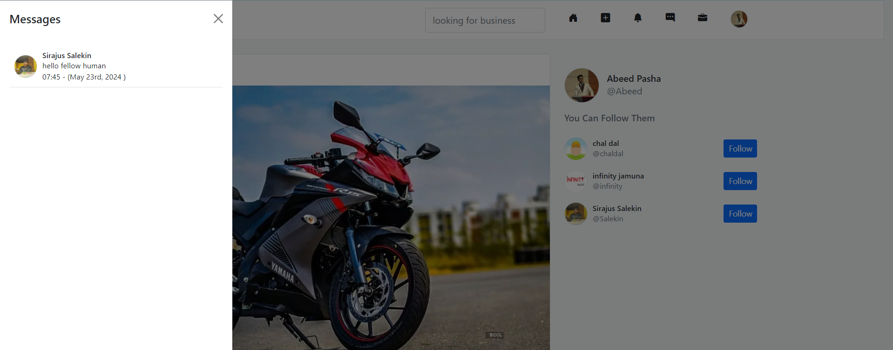

Slide 35
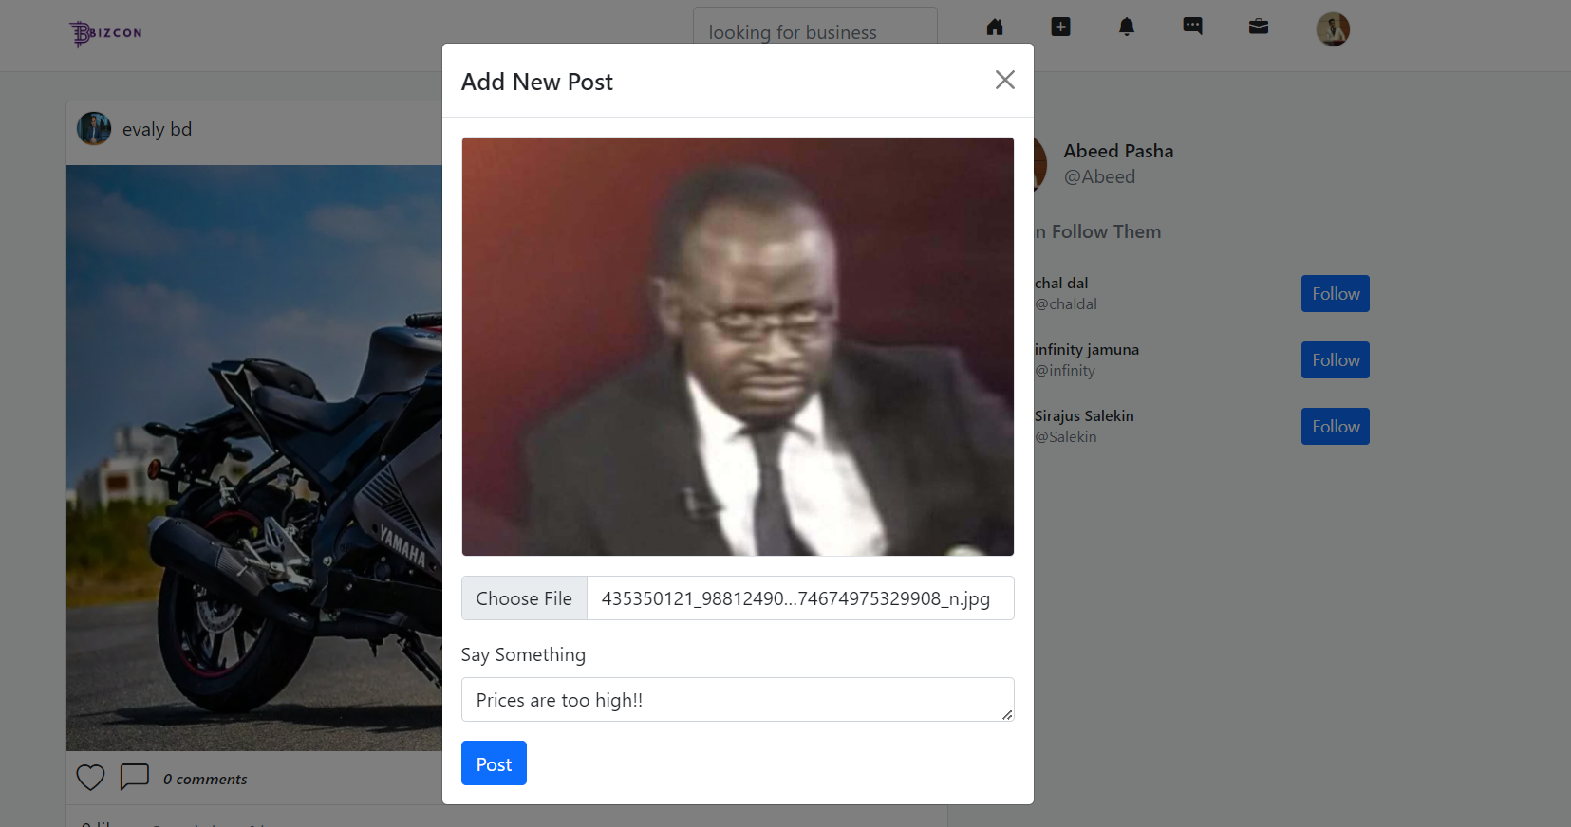

Slide 36
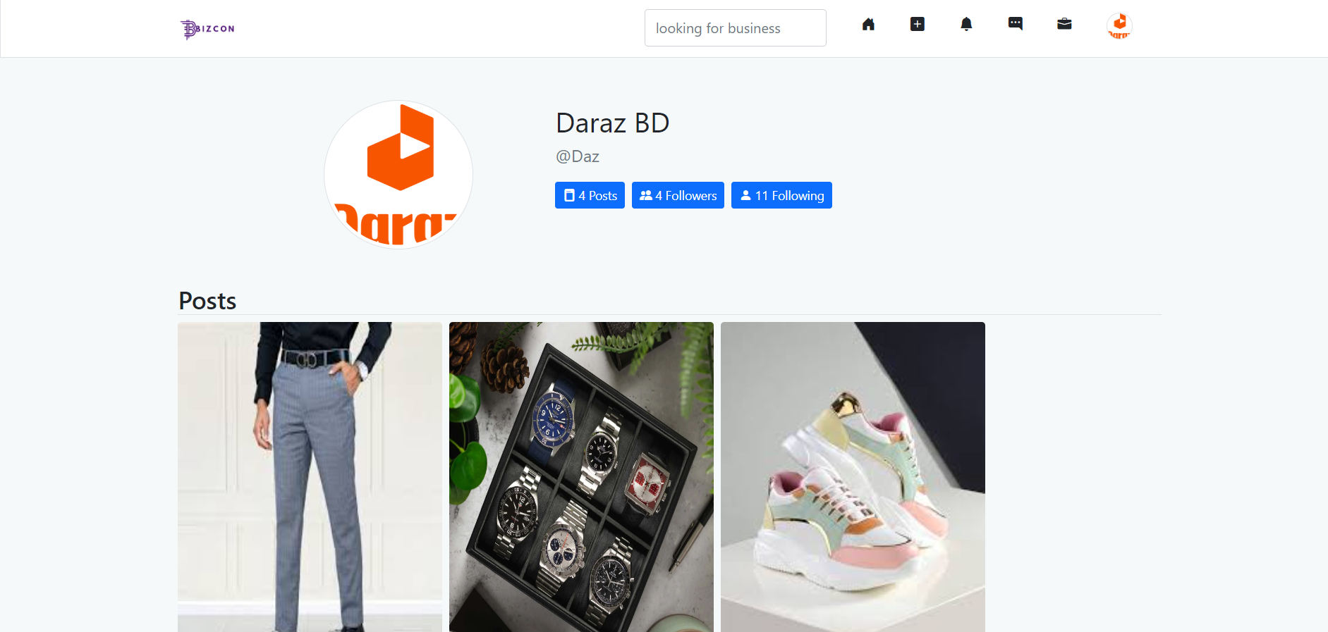

Slide 37
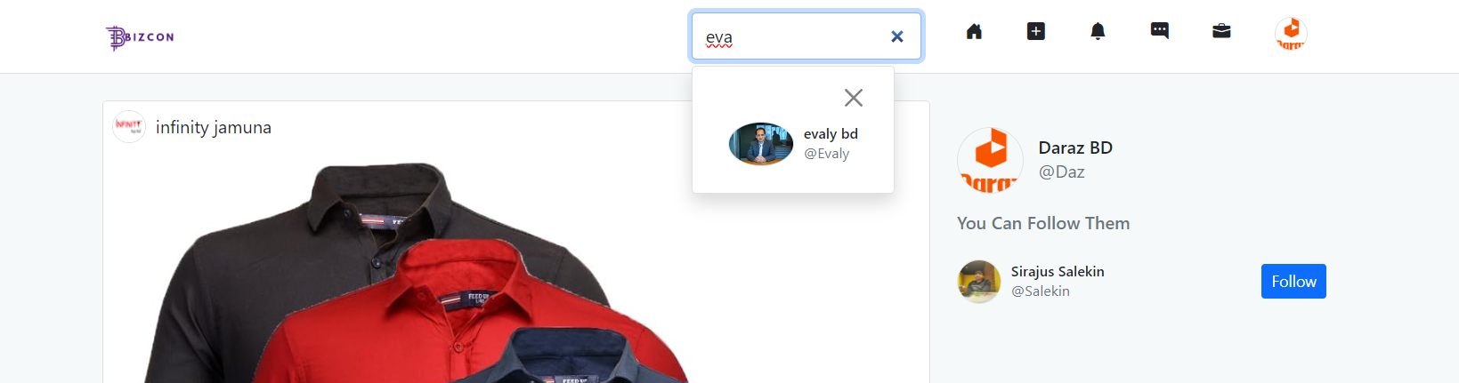

Slide 38
Thank You

